Slide 1


"SQL DataAnalysis on Hotel Industry"

Slide 2
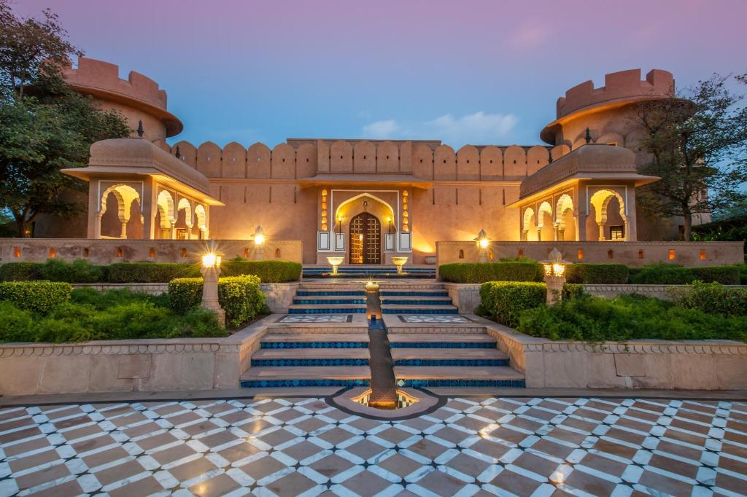
Objective In this project, we analyze a hotel booking dataset to uncover key insights related to customer behavior, booking cancellations, revenue, and trends. The dataset includes various features such as booking status, lead time, market segments, room types, and ADR (Average Daily Rate). The goal is to understand patterns in cancellations, revenue generation, customer segmentation, and overall booking dynamics, which can help hotels optimize their operations and enhance customer satisfaction.

Slide 3

Dataset column overview
hotel: The type of hotel (Categorical)
is_canceled: Indicates whether the booking was canceled (Binary)
lead_time: The number of days between the booking date and the arrival date (Numerical)
arrival_date_year: The year of the arrival date (Numerical)
arrival_date_month: The month of the arrival date (Categorical)
arrival_date_week_number: The week number of the arrival date (Numerical)
arrival_date_day_of_month: The day of the month of the arrival date (Numerical)
stays_in_weekend_nights: The number of weekend nights (Saturday and Sunday) the guest stayed or booked to stay at the hotel (Numerical)
stays_in_week_nights: The number of weeknights (Monday to Friday) the guest stayed or booked to stay at the hotel (Numerical)
adults: The number of adults included in the booking (Numerical)
children: The number of children included in the booking (Numerical)
babies: The number of babies included in the booking (Numerical)

Slide 4
country: The country of origin for each guest who made a reservation (Categorical)
market_segment: The market segment that individuals belong to when making reservations (Categorical)
distribution_channel: The channel through which bookings were made (Categorical)
is_repeated_guest: Indicates whether the guest is a repeated visitor (Binary)
previous_cancellations: The number of times guests previously canceled their bookings (Numerical)
previous_bookings_not_canceled: The count of previous bookings made by guests that were not canceled (Numerical)
reserved_room_type: The type of room initially reserved (Categorical)
assigned_room_type: The type of room that was assigned to guests. (Categorical)
booking_changes: The number of changes made to the booking. (Numerical)
deposit_type: The type of deposit made for the booking. (Categorical)
agent: The ID of the travel agency that made the booking. (Categorical)
company: The ID of the company that made the booking. (Categorical)
days_in_waiting_list: The number of days the booking was on the waiting list before being confirmed. (Numerical)
customer_type: The type of customer (e.g., transient, contract, group, or other). (Categorical)

Slide 5
adr: The average daily rate (price per room) for the booking. (Numerical)
required_car_parking_spaces: The number of car parking spaces required by the guest. (Numerical)
total_of_special_requests: The total number of special requests made by the guest (e.g., extra bed, room amenities). (Numerical)
reservation_status: The status of the reservation (e.g., canceled, checked-in, no-show). (Categorical)
reservation_status_date: The date on which the reservation status was last updated. (Date)

Slide 6

Sql queries and their results

Slide 7
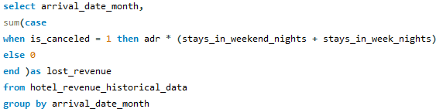
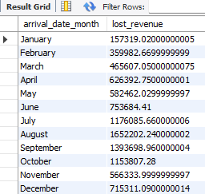
1. Revenue Lost Due to Cancellations by Month.

Slide 8
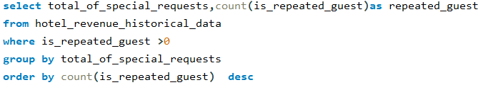
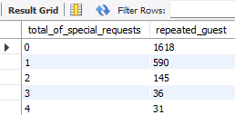
2. Repeat Guest Analysis Based on Special Requests.

Slide 9
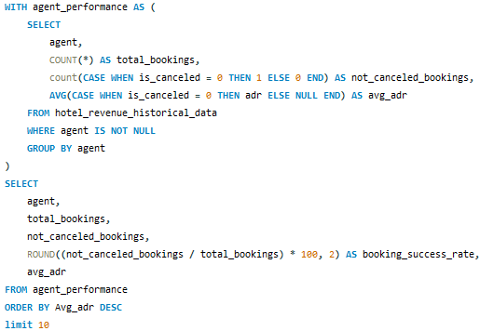
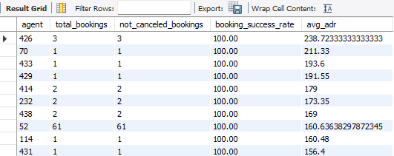
3. Which travel agents (agent) have the highest percentage of bookings that were not canceled, and how do they impact the adr.

Slide 10
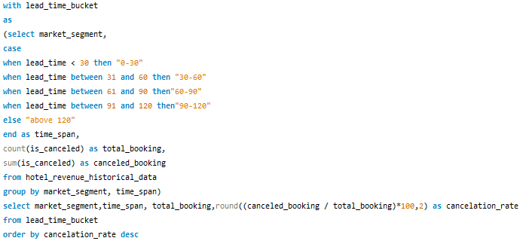
4. What is the cancellation rate for each market_segment, and how does it change based on the lead_time bucketed into ranges (0-30, 31-60, etc. Result on next slide

Slide 11
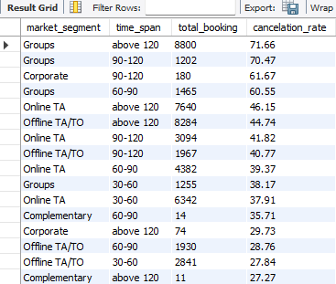
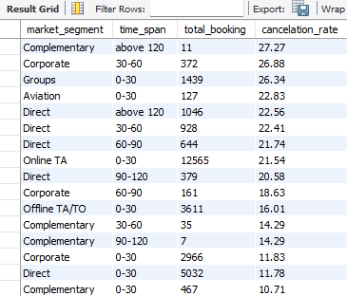

Slide 12
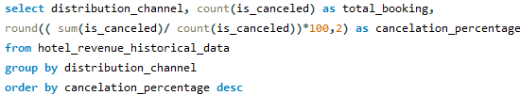
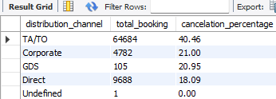
5. Which distribution_channel brings the highest percentage of bookings and has the lowest cancellation rate .

Slide 13
Conclusion Booking Trends: From the analysis of the market segments, we observed notable variations in booking and cancellation behavior. For instance, Corporate bookings tend to have a lower cancellation rate, indicating more stable bookings compared to Online Travel Agents (OTA), which show a higher likelihood of cancellations. This insight can be crucial for hotels to target direct bookings or corporate deals with personalized incentives and flexible terms, while managing OTA bookings with stricter cancellation policies or prepayment options to reduce losses. Revenue Insights: Cancellations have a significant impact on revenue. The findings show that revenue lost due to cancellations increases during peak seasons when demand is high. This highlights the importance of developing strategies to reduce cancellations, such as offering non-refundable bookings during high-demand months, or incentivizing guests to stick to their bookings through discounts or upgrades. By minimizing cancellations, the hotel can ensure higher room occupancy and stable revenue, especially in high-revenue months. Customer Behavior: The data suggests that repeat guests generally have lower cancellation rates and show higher loyalty. Furthermore, those with special requests often spend more and contribute to higher average daily rates (ADR). By focusing on enhancing the experience for repeat customers, such as offering personalized services or loyalty rewards, hotels can foster long-term relationships and increase revenue per customer. This could also include predictive marketing based on guest behavior, ensuring these loyal customers return regularly.

Slide 14
Operational Suggestions: The analysis of distribution channels shows that certain channels, such as direct bookings and corporate bookings, tend to bring a higher percentage of non-canceled reservations. In contrast, channels like OTAs, while useful for reaching a wide audience, have a higher cancellation rate. Hotels should consider optimizing marketing efforts towards channels that guarantee better retention and reduce reliance on high-cancellation platforms. Additionally, promoting direct booking incentives through the hotel’s website can improve margins by bypassing third-party commission fees

Slide 15

THANK YOU
Vaibhav Agrawal

